Slide 1

presented by:-
Name of student: Bhupinder Singh
Registration number: 12215458

Slide 2
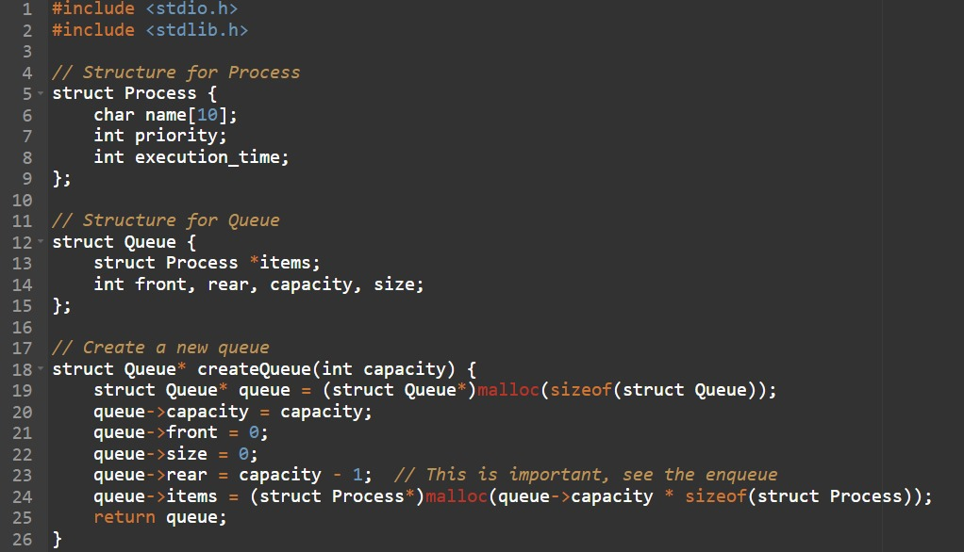
Ques. Design a scheduling program to implements a Queue with two levels:
Level 1 : Fixed priority preemptive Scheduling
Level 2 : Round Robin Scheduling
For a Fixed priority preemptive Scheduling (Queue 1), the Priority 0 is highest priority. If one process P1 is scheduled and running, another process P2 with higher priority comes. The New process (high priority) process P2 preempts currently running process P1 and process P1 will go to second level queue. Time for which process will strictly execute must be considered in the multiples of 2..
All the processes in second level queue will complete their execution according to round robin scheduling.
Consider: 1. Queue 2 will be processed after Queue 1 becomes empty.
2. Priority of Queue 2 has lower priority than in Queue 1.
Ans: The scheduling program in C language implements two-level scheduling:
**Level 1 (Queue 1): Fixed Priority Preemptive Scheduling**
- Priority 0 is the highest priority.
- If a higher priority process arrives, it preempts the running process.
- Processes run in strict 2-unit time slices.
- Preempted processes move to Queue 2.
**Level 2 (Queue 2): Round Robin Scheduling**
- Processes from Queue 1 move here when it becomes empty.
- Round robin scheduling with a time quantum of 2 units.
- Lower priority than Queue 1.
The program processes Queue 1 first, then Queue 2, completing when both queues are empty.

Slide 3
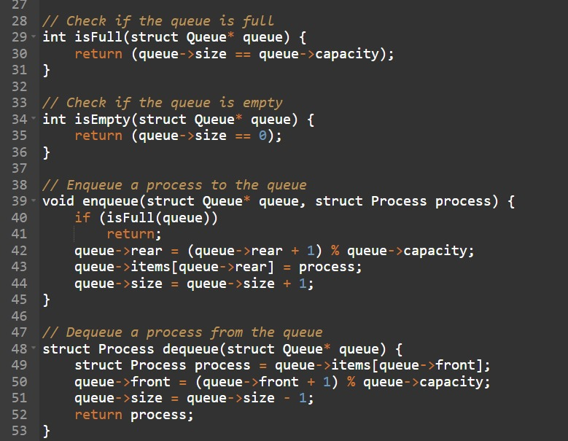
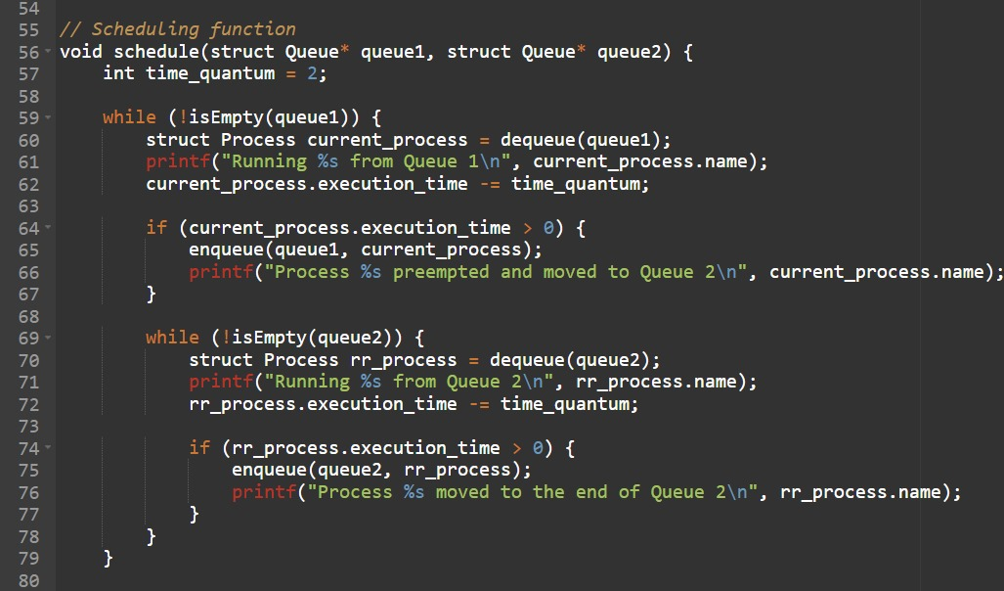

Slide 4
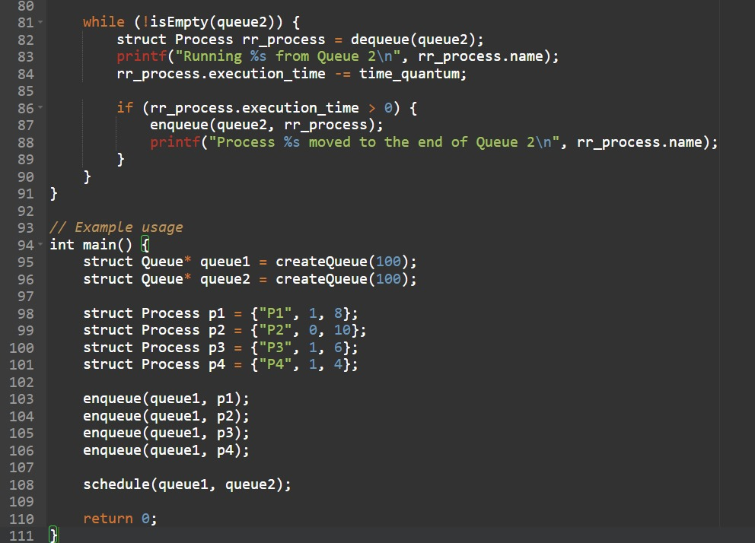
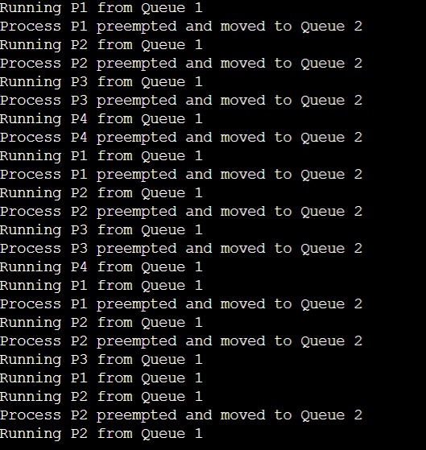
The output of the provided C program. Here's the expected output:

